Slide 1
WASHING MACHINE SIMULATION
Project Presented By:
Name: PRAJWAL M S
USN: 1VE18EC070
Email: gowdaprajwal009@gmail.com
College: Sri Venkateshwara College of Engineering, Bangalore

Slide 2
C-Programming
C Program is used in System Software Development, Embedded Software Development, OS Kernel Development, Firmware, Middle-ware and Driver Development, File System Development and many more.
C-used effectively in various specific domains and it is a free-formatted language and efficiency and portability.
Number systems-Decimal, Octal, Hexadecimal, Binary
Data representation-bit, byte, word
Integrated number-positive, negative
Data-type-integral(Char, int), Floating point(float, double)
CONDITIONAL CONSTRUCTS:
Single iteration-if, if else, if else if and switch case
Multiple iteration-while, do while, for
Unconditional-continue, break

Slide 3
Learnt from Embedded C
Operators-Operates on its Operands, Returns a value
Array-collection of data of same data type. Address are sequential.
Pointer-parameter passing mechanism in function, by passing the reference
Function-Pass by Value and Pass by reference(Return more than one value from a function), Passing array, returning array and recursive.
Strings-Contiguous Sequence of characters, easily stores ASCII and its extensions.
Storage class-auto, register, static local, static global and extern.

Slide 4
Micro Controller
An Integrated Circuit which is capable of being programmed to perform a specific task.
All components in single chip, less flexible, Less design complexity.
Things to be noted when choosing microcontroller:-
Application
Performance, Price
Availability of Tools
Special Capabilities
MICROPROCESSOR:
A microprocessor is a computer processor wherein the data processing logic and control is included on a single integrated circuit, or a small number of integrated circuits.
All separate components, More flexible, More design complexity.

Slide 5
EMBEDDED SYSTEMS
Any combination of Hardware and Software which is intended to do a specific task can be called as an Embedded system.
Categories-Stand-alone-Real Time, Networked, Mobile
Challenges in ES-Efficient Input/output, Embedding an OS, Code Optimization Testing and Debugging.
Real Time Aspects:
Hard Real Time– Should meet its deadline Life Critical Application.
Firm Real Time – Similar to Hard Real Time.
Soft Real Time- Can have tolerance in meeting its deadline.

Slide 6
Installation of Software and LED
We have Installed the following software’s.
MPLAB X IDE
Picsim Lab
Xc8 compiler
Interfaces LED’s Introduction:
Simplest device used in most on the embedded application as feedback, works just like diodes.
LED basic program demo:
Basic LED program-Toggling LED’s connected to port B(PIC16F877A).
Build hex file in mplab x ide software then in picsim lab software load the hex file in.
Board-pic genios board.
Microcontroller-PIC16F877A.

Slide 7
MPLAB X IDE
MPLAB X IDE is an expandable, highly configurable software program that incorporates powerful tools to helps you discover, configure, develop, debug and qualify embedded design for most of our microcontroller and digital signal controllers.
MPLAB supports project management, editing, debugging and programming of Microchip 8-bit, 16-bit and 32-bit PIC microcontrollers. It only works on Microsoft Windows.
MPLAB is a proprietary freeware integrated development environment for the development of embedded applications on PIC and dsPIC microcontrollers, and is developed by Microchip Technology.

Slide 8
PICSIM LAB
PicsimLab is a real-time emulate of development boards with integrated MPLABX/avr-gdb debugger. For code editing and debugging the same tools used for a real board should be used with PicsimLab, such as MPLABX or Arduino IDE.
Xc8 COMPILER
Xc8 is a C compiler from Microchip for 8-bit PICs. Both programs run on windows, Max OS X, and Linux.

Slide 9
PICGenios-PIC16F877A
The PIC16F877A features 256 bytes of EEPROM data memory, self programming, an LCD, 2 Comparators, 8 channels of 10-bit Analog-to-Digital converter, 2 capture/compare/PWM function, the synchronous serial port can be configured as either 3-wire Serial Peripheral Interface (SPI) or the 2-wire Inter-Integrated.
PIC16F877A is a 40-pin PIC Microcontroller, designed using RISC architecture, manufactured by Microchip and is used in Embedded Projects. It has five Ports on it, starting from Port A to Port E. It has three Timers in it, two of which are 8-bit Timers while 1 is of 16 Bit.

Slide 10
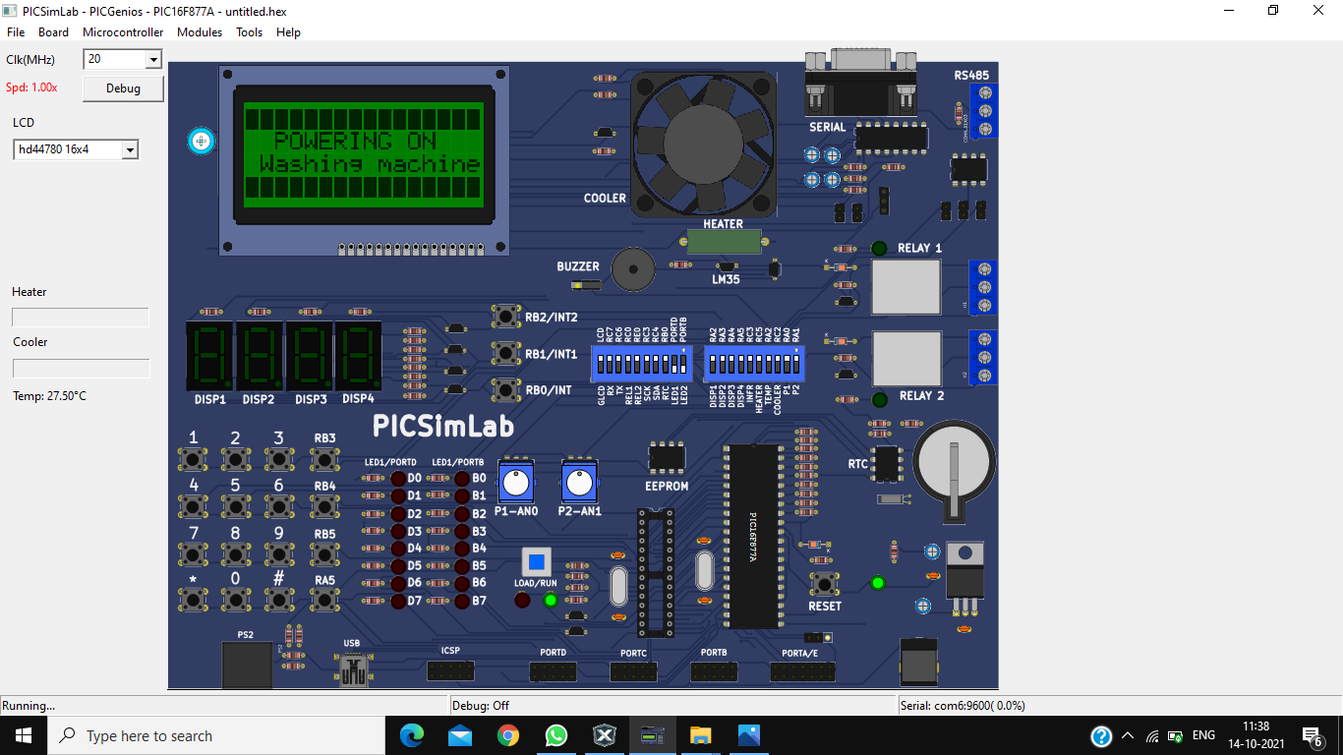
PIC16F877A BOARD

Slide 11
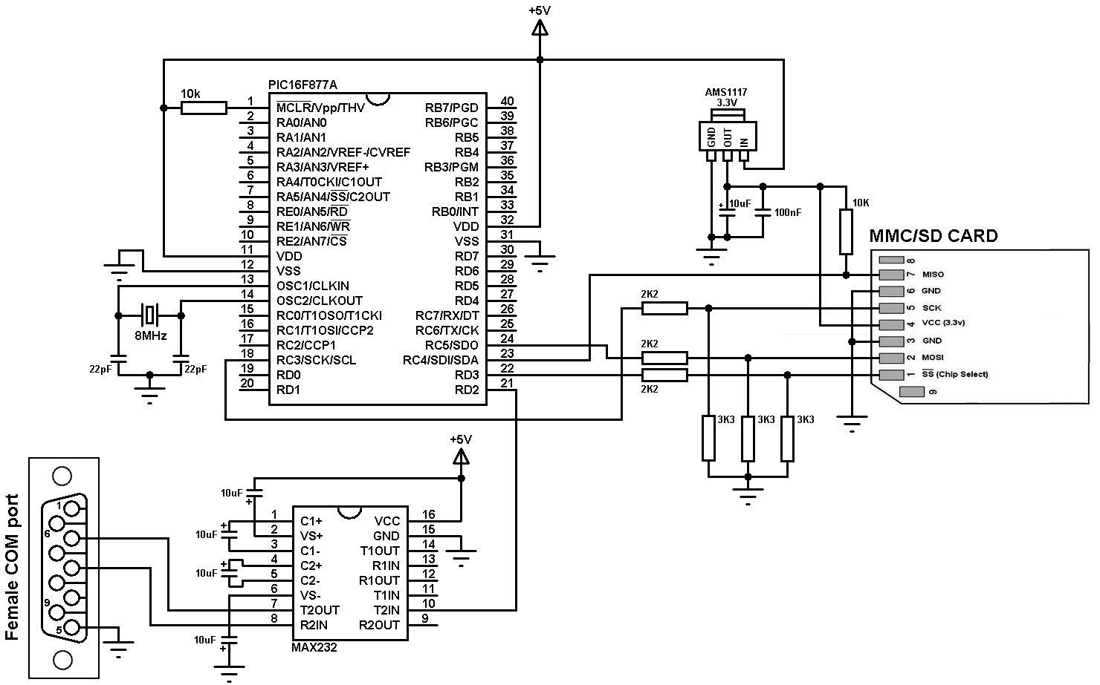
PIC16F877A BOARD ARCHITECTURE

Slide 12
CLCD
CLCD=>Character Liquid Crystal Display.
It has two type of display, they are 16*2 and 16*4.
Used to display all ASCII character and symbol It has totally 16 interfacing lines.
D0 to D7 are data transfer line. That controller can execute the Instruction and data.
RS line – REGISTER SELECT LINE.
RS value is 1-> Data…
RS value is 0->Instruction…

Slide 13
DATA PROCESSION IN CLCD
Data Processed by two methods
Delay Method
Poll D7 method
In Poll D7 Method, we want to continuously monitor D7. In data lines, we are providing data.
R/W=1=>Read.
R/W=0=>Write.
In R/W pin is permanently grounded, that means only write an data.
In CLCD, D0 to D7 are connected to PortD & RS and Enable pin are connected to PortE.
8 bit->D0 to D7.
4bit->D4 to D7.
Enable pin act as indicator by apprising LCD about the inception of data transmission by the microcontroller.

Slide 14
TACTILE SWITCHES
In matrix keypad, we need to configure ROWS as OUTPUT & COLUMNS as INPUT.
When designing pull down interface, R1 is 10 times greater then R2.[R1>10R2].
TIGGERING METHODS:
Edge trigger.
Level trigger.
Bouncing Effect:
There is a metal plate and terminal. Spurious pulse detection while pressing /releasing the tactile switch is called bouncing effect.

Slide 15
MATRIX KEYPAD
Used when the more number of user inputs is required and still want to save the controller I/O lines.
Uses row and columns concept.
Most commonly used in Telephone, digital lockers and calculators many more.
In the cooking mode the matrix keypad keys are used to select the respective modes.
Tactile Keyboard:
A key switch is tactile if it is has a bump in its response to finger pressures at or near the engagement point where the key press registers and before the key bottoms out at the end of its travel. A keyboard is tactile if it made with tactile key switches.

Slide 16
TIMERS
It has three modes like:
1) PWM or pulse generator
2)Counter.
PW or PP measurement etc.,
Tick—>Up count or down count
Quantum->System clock setting
Scaling->Pre or post
Resolution->register width.
The micro mode and grill mode are under the operational mode.
And the timer is set with Matrix key pas * to clear and # to enter.
To toggle the LED 8 bit resolution is required.

Slide 17
WASHING MACHINE SIMULATION USING PICSIMLAB SOFTWARE

Slide 18

Powering on of washing machine

Slide 19
Washing Machine is in ON mode

Slide 20

Select the Washing Program

Slide 21

Select the Washing Program

Slide 22

Select the types of Clothes

Slide 23

Select the types of Clothes

Slide 24

Select the types of Clothes

Slide 25

Select the Water Level

Slide 26

Select the Water Level

Slide 27

Select the Water Level

Slide 28

Start and Stop of Wash

Slide 29

Setting up the Washing Time

Slide 30

Starting the Wash

Slide 31

If Door is open, Buzzer will make sound

Slide 32

After completing the wash, display will print the message as remove clothes

Slide 33
Lets See the Actual Working

